Slide 1
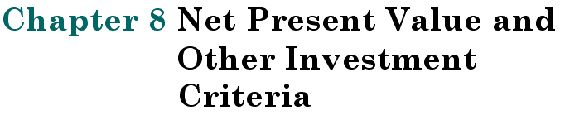
Notes:
8.<number>

Slide 2
Key Concepts and Skills
Understand:
  The payback rule and its shortcomings
  Accounting rates of return and their problems
  The internal rate of return and its strengths and weaknesses
  The net present value rule and why it is the best decision criteria
  The modified internal rate of return
  The profitability index and its relation to NPV
Notes:
8.<number>

Slide 3
Chapter Outline
8.1 Net Present Value
8.2 The Payback Rule
8.3 The Average Accounting Return
8.4 The Internal Rate of Return
8.5 The Profitability Index
8.6 The Practice of Capital Budgeting
Notes:
8.<number>

Slide 4
Capital Budgeting
Analysis of potential projects
Long-term decisions
Large expenditures
Difficult/impossible to reverse
Determines firm’s strategic direction
Notes:
8.<number>

Slide 5
Good Decision Criteria
All cash flows considered?
TVM considered?
Risk-adjusted?
Ability to rank projects?
Indicates added value to the firm?
Notes:
8.<number>

Slide 6
Net Present Value
How much value is created from undertaking an investment?
  Step 1: Estimate the expected future cash flows.
  Step 2: Estimate the required return for projects of this risk level.
  Step 3: Find the present value of the cash flows and subtract the initial investment to arrive at the Net Present Value.
Notes:
8.<number>

Slide 7
Net Present Value
NPV = –Initial Cost + Market Value
NPV = – Initial Cost + PV(Expected Future CF’s)
Notes:
8.<number>

Slide 8
More on the Appropriate
Discount Rate, R
Discount rate = opportunity cost of capital
  Expected rate of return given up by investing in the project
  Reflects the risk of the cash flows from the project
Discount rate does not reflect the risk of the firm or the risk of the firm’s previous projects (remember: the past is irrelevant)

Slide 9
Net Present Value
Sum of the PVs of all cash flows
n
CF_{t}
∑
NPV =
(1 + R)^{t}
t = 0
NOTE: t=0
Initial cost often is CF₀ and is an outflow.
n
CF_{t}
∑
- CF₀
NPV =
(1 + R)^{t}
t = 1
where R reflects the risk of the project’s cash flows
Notes:
8.<number>

Slide 10
NPV – Decision Rule
If NPV is positive, accept the project
NPV > 0 means:
  Project is expected to add value to the firm
  Will increase the wealth of the owners
NPV is a direct measure of how well this project will meet the goal of increasing shareholder wealth.
Notes:
8.<number>

Slide 11
Sample Project Data
You are looking at a new project and have estimated the following cash flows, net income and book value data:
  Year 0: CF = -165,000
  Year 1: CF = 63,120 NI = 13,620
  Year 2: CF = 70,800 NI = 3,300
  Year 3: CF = 91,080 NI = 29,100
  Average book value = $72,000
Your required return for assets of this risk is 12%.
This project will be the example for all problem exhibits in this chapter.
Notes:
8.<number>

Slide 12
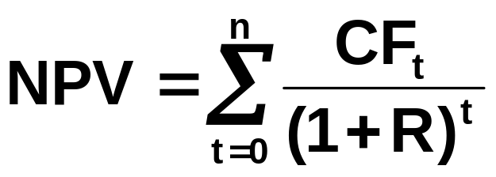
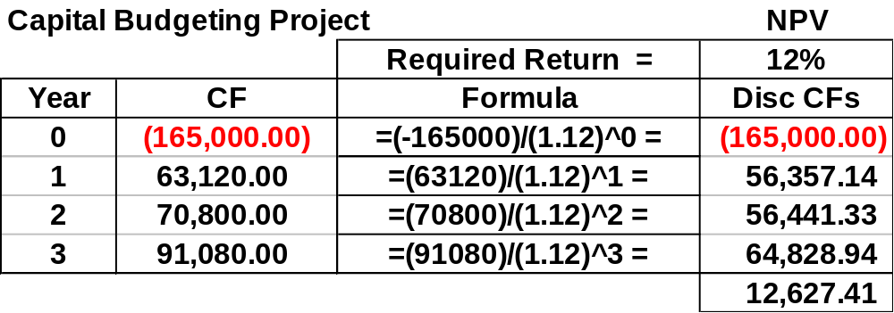
Computing NPV for the Project
Using the formula:
  NPV = -165,000/(1.12)⁰ + 63,120/(1.12)¹ + 70,800/(1.12)² + 91,080/(1.12)³ = 12,627.41
Notes:
8.<number>

Slide 13
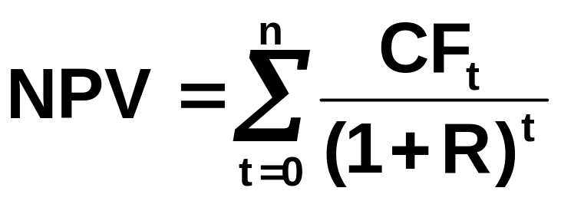
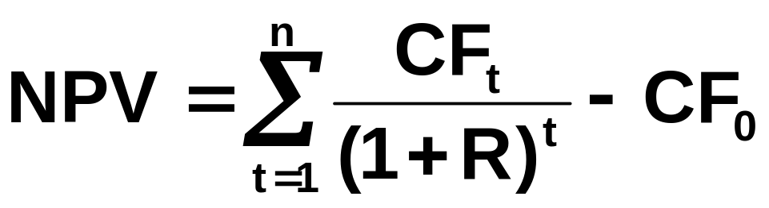
Net Present Value
Sum of the PVs of all cash flows.
<< CALCULATOR
<< EXCEL
Notes:
8.<number>

Slide 14
Rationale for the NPV Method
NPV = PV inflows – Cost
  NPV=0 → Project’s inflows are “exactly sufficient to repay the invested capital and provide the required rate of return”
NPV = net gain in shareholder wealth
Rule: Accept project if NPV > 0
Notes:
8.<number>

Slide 15
NPV Method
  Meets all desirable criteria
    Considers all CFs
    Considers TVM
    Adjusts for risk
    Can rank mutually exclusive projects
  Directly related to increase in V_{F}
  Dominant method; always prevails
Notes:
8.<number>

Slide 16
Example
Should a company invest in the following project? It requires an initial investment of $ 1,700 and is expected to generate the following positive cash flows:
  Year Cash Flow ($)
1 500
2 1,000
3 1,200
Assume the company requires a return of 10% on this type of project.

Slide 17
Using the NPV Rule
Your firm is considering whether to invest in a new product. The costs associated with introducing this new product and the expected cash flows over the next four years are listed below. (Assume these cash flows are 100% likely). The appropriate discount rate for these cash flows is 20% per year. Should the firm invest in this new product?
Costs: ($ million)
Promotion and advertising 100
Production & related costs 400
Other 100
Total Cost 600
Initial Cost: $600 million and r = 20%
The cash flows ($million) over the next four years:
Year 1: $200; Year 2: $220; Year 3: $225; Year 4: $210
Should the firm proceed with the project?

Slide 18
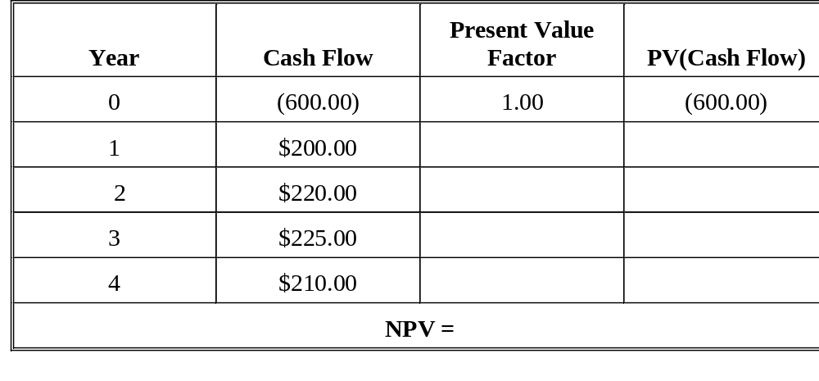
Using NPV, concluded
(1.20)¹ 166.67
(1.20)² 152.78
(1.20)³ 130.21
(1.20)⁴ 101.27
(49.07)
Notes:
Two comments:
1) Process of discounting is not that important. Coming up with the appropriate discount rate and cash flows is the key.
2) NPV is an estimate.

Slide 19
Value additivity property of NPV rule
Definition: Projects A and B are independent if they don’t affect each other’s cash flows
Definition (Value Additivity): We will say that an investment rule satisfies value additivity if the following holds:
if C is independent of A and B, then
A is preferred to B ⇔ A + C is preferred to B + C
If X and Y are independent NPV(X+Y) = NPV(X)+NPV(Y) – hence, NPV rule satisfies value additivity

Slide 20
Calculating A Project’s NPV-
An Example
Quickie Enterprise’s Microprocessor Plant
Cash Flows in $ million
Year Cash Flow PVIF@12% Present Value
0 -$400 1.0000 -$400.00
1 100 0.8929 89.29
2 110 0.7972 87.69
3 120 0.7118 85.41
4 130 0.6355 82.62
5 140 0.5674 79.44
NPV = $24.45

Slide 21
Pros and Cons Of Using NPV As Decision Rule
NPV is the “gold standard” of investment decision rules
Key benefits of using NPV as decision rule
  Focuses on cash flows, not accounting earnings
  Makes appropriate adjustment for time value of money
  Can properly account for risk differences between projects
Though best measure, NPV has some drawbacks
  Lacks the intuitive appeal of payback
  Doesn’t capture managerial flexibility (option value) well

Slide 22
Payback Period
How long does it take to recover the initial cost of a project?
Computation
  Estimate the cash flows
  Subtract the future cash flows from the initial cost until initial investment is recovered
  A “break-even” type measure
Decision Rule – Accept if the payback period is less than some preset limit
Notes:
8.<number>

Slide 23
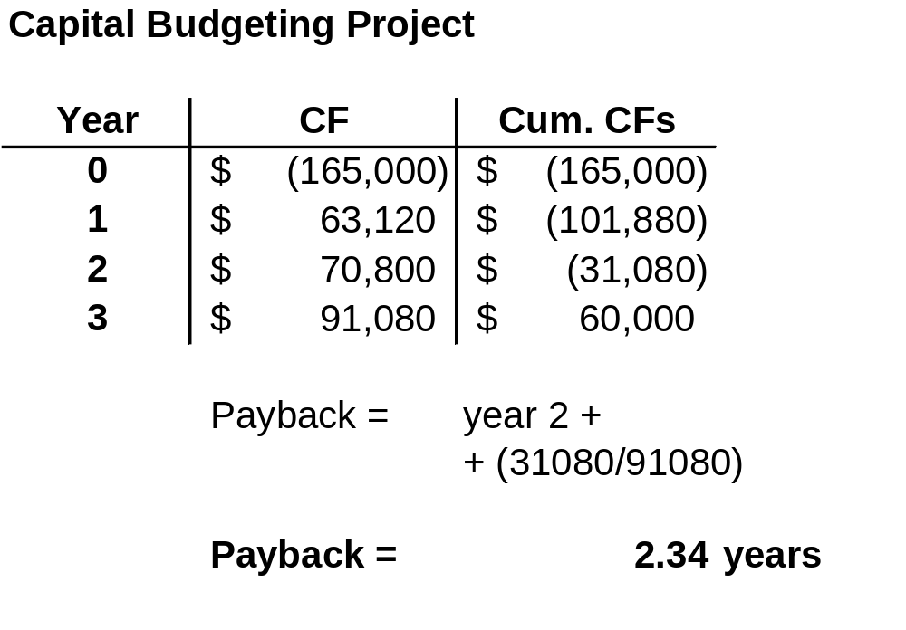
Computing Payback for the Project
Do we accept or reject the project?
Notes:
8.<number>

Slide 24
Decision Criteria Test
Payback
Does the payback rule:
  Account for the time value of money?
  Account for the risk of the cash flows?
  Provide an indication about the increase in value?
  Permit project ranking?
Should we consider the payback rule for our primary decision rule?
Notes:
8.<number>

Slide 25
Advantages and Disadvantages of Payback
Advantages
  Easy to understand
  Adjusts for uncertainty of later cash flows
  Biased towards liquidity
Disadvantages
  Ignores the time value of money
  Requires an arbitrary cutoff point
  Ignores cash flows beyond the cutoff date
  Biased against long-term projects, such as research and development, and new projects
ASKS THE WRONG QUESTION!
Notes:
8.<number>

Slide 26
Pros And Cons Of Payback Method
Advantages of payback method:
  Computational simplicity
  Easy to understand
  Focus on cash flow
Disadvantages of payback method:
  Does not account properly for time value of money
  Does not account properly for risk
  Cutoff period is arbitrary
  Does not lead to value-maximizing decisions

Slide 27
Discounted Payback Period
Discounted payback accounts for time value
  Apply discount rate to cash flows during payback period
  Still ignores cash flows after payback period

Slide 28
100
100
100
100
100
100
Project A
0
1
2
3
4
5
6
PB = 4.5 yrs
450
90
90
90
90
90
200
Project B
0
1
2
3
4
5
6
PB = 5 yrs
450
Project A has a shorter PB period but is it really the more preferable project? Compute NPV of each project (assume r = 8%):
NPV_{A} =12.28
NPV_{B} = 35.38

Slide 29
Discounted Payback Period
  Similar to the Payback Period
  Expected future cash flows are discounted by the project’s cost of cap
  Thus the discounted payback period is defined as the number of years required to recover the investment from discounted net cash flows.
  Payback period = the length of time before the original cost of
  an investment is recovered from the expected cash flows
Decision Rule:
  Accept project if its payback period < Company’s cutoff criteria.
  Otherwise reject.

Slide 30
Strengths & Weaknesses of the Discounted Payback Method:
Strengths
    Provides an indication of a project’s liquidity risk
    Easy to calculate and understand
    Recognizes time value of money
    Recognizes opportunity cost of capital
Weaknesses
    Ignores the CFs occurring after the payback period

Slide 31
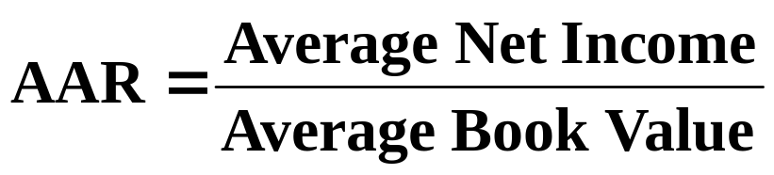
Average Accounting Return
Many different definitions for average accounting return (AAR)
In this book:
  Note: Average book value depends on how the asset is depreciated.
Requires a target cutoff rate
Decision Rule: Accept the project if the AAR is greater than target rate.
Notes:
8.<number>

Slide 32
Computing AAR for the Project
Sample Project Data:
  Year 0: CF = -165,000
  Year 1: CF = 63,120 NI = 13,620
  Year 2: CF = 70,800 NI = 3,300
  Year 3: CF = 91,080 NI = 29,100
  Average book value = $72,000
Required average accounting return = 25%
Average Net Income:
  ($13,620 + 3,300 + 29,100) / 3 = $15,340
AAR = $15,340 / 72,000 = .213 = 21.3%
Do we accept or reject the project?
Notes:
8.<number>

Slide 33
ARR Formula
The formula for ARR is:
ARR = Average Annual Profit / Average Investment
Where:
Average Annual Profit
= Total profit over Investment Period / Number of Years
Average Investment
= (Book Value at Year 1 + Book Value at End of Useful Life) / 2
Components of ARR
If the ARR is equal to 5%, this means that the project is expected to earn five cents for every dollar invested per year.
In terms of decision making, if the ARR is equal to or greater than a company’s required rate of return, the project is acceptable because the company will earn at least the required rate of return.
If the ARR is less than the required rate of return, the project should be rejected. Therefore, the higher the ARR, the more profitable the company will become.

Slide 34
ARR – Example 1
Lenden Company is looking to invest in some new machinery to replace its current malfunctioning one. The new machine, which costs $420,000, would increase annual revenue by $200,000 and annual expenses by $50,000. The machine is estimated to have a useful life of 12 years and zero salvage value.
Step 1: Calculate Average Annual Profit
Inflows, Years 1-12
(200,000*12)
$2,400,000
Less: Annual Expenses
(50,000*12)
-$600,000
Less: Depreciation
-$420,000
Total Profit
$1,380,000
Average Annual Profit
(1,380,000/12)
$115,000
Step 2: Calculate Average Investment
Average Investment
($420,000 + $0)/2 = $210,000
Step 3: Use ARR Formula
ARR = $115,000/$210,000 = 54.76%
Therefore, this means that for every dollar invested, the investment will return a profit of about 54.76 cents.

Slide 35
ARR – Example 2
Lenden Company is considering investing in a project that requires an initial investment of $100,000 for some machinery. There will be net inflows of $20,000 for the first two years, $10,000 in years three and four, and $30,000 in year five. Finally, the machine has a salvage value of $25,000.
Step 1: Calculate Average Annual Profit
Inflows, Years 1 & 2 (20,000*2) $40,000
Inflows, Years 3 & 4 (10,000*2) $20,000
Inflow, Year 5 $30,000
Less: Depreciation (100,000-25,000) -$75,000
Total Profit $15,000
Average Annual Profit (15,000/5) $3,000
Step 2: Calculate Average Investment
Average Investment ($100,000 + $25,000) / 2 = $62,500
Step 3: Use ARR Formula
ARR = $3,000/$62,500 = 4.8%

Slide 36
Decision Criteria Test - AAR
Does the AAR rule account for the time value of money?
Does the AAR rule account for the risk of the cash flows?
Does the AAR rule provide an indication about the increase in value?
Should we consider the AAR rule for our primary decision criteria?
Notes:
8.<number>

Slide 37
Advantages and Disadvantages of AAR
Advantages
  Easy to calculate
  Needed information usually available
Disadvantages
  Not a true rate of return
  Time value of money ignored
  Uses an arbitrary benchmark cutoff rate
  Based on accounting net income and book values, not cash flows and market values
Notes:
8.<number>

Slide 38
Internal Rate of Return
Most important alternative to NPV
Widely used in practice
Intuitively appealing
Based entirely on the estimated cash flows
Independent of interest rates
Notes:
8.<number>

Slide 39
IRR
Definition and Decision Rule
Definition:
  IRR = discount rate that makes the NPV = 0
Decision Rule:
  Accept the project if the IRR is greater than the required return
Notes:
8.<number>

Slide 40
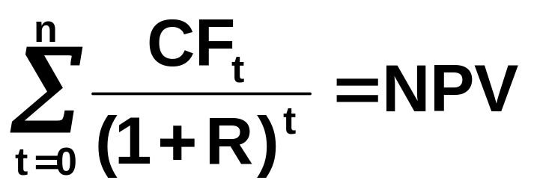
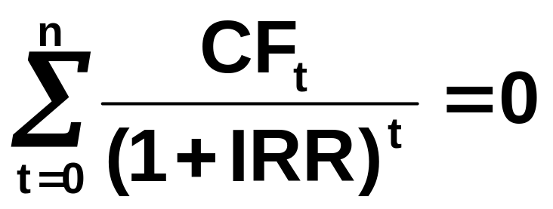
NPV vs. IRR
NPV: Enter r, solve for NPV
IRR: Enter NPV = 0, solve for IRR.
Notes:
8.<number>

Slide 41
Computing IRR For The Project
Without a financial calculator or Excel, this becomes a trial-and-error process
Calculator
  Enter the cash flows as for NPV
  Press IRR and then CPT
  IRR = 16.13% > 12% required return
Do we accept or reject the project?
Notes:
8.<number>

Slide 42
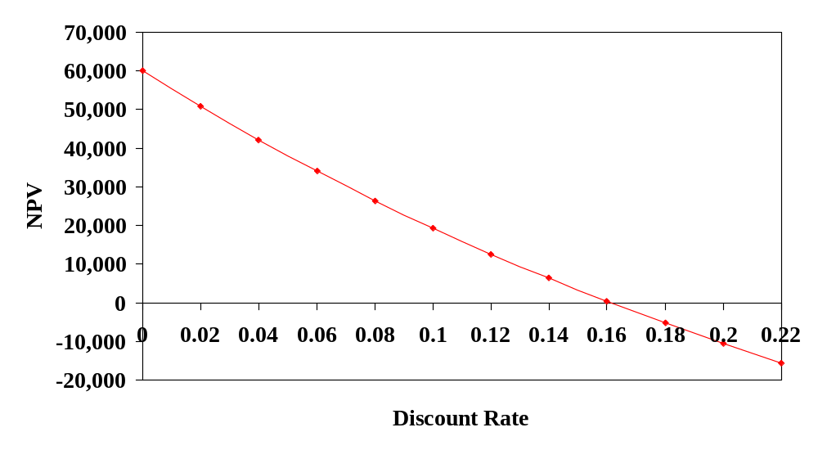
NPV Profile For The Project
IRR = 16.13%
Notes:
8.<number>

Slide 43
Decision Criteria Test
IRR
Does the IRR rule:
  Account for the time value of money?
  Account for the risk of the cash flows?
  Provide an indication about the increase in value?
  Permit project ranking?
Should we consider the IRR rule for our primary decision criteria?
Notes:
8.<number>

Slide 44
IRR - Advantages
Preferred by executives
  Intuitively appealing
  Easy to communicate the value of a project
If the IRR is high enough, may not need to estimate a required return
Considers all cash flows
Considers time value of money
Provides indication of risk
Notes:
8.<number>

Slide 45
IRR - Disadvantages
Can produce multiple answers
Cannot rank mutually exclusive projects
Reinvestment assumption flawed
Notes:
8.<number>

Slide 46
Summary of Decisions for the Project
Summary
Net Present Value | Accept
Payback Period | ???
Average Accounting Return | ???
Internal Rate of Return | Accept
Notes:
8.<number>

Slide 47
NPV vs. IRR
NPV and IRR will generally give the same decision
Exceptions
  Non-conventional cash flows
    Cash flow sign changes more than once
  Mutually exclusive projects
    Initial investments are substantially different
    Timing of cash flows is substantially different
    Will not reliably rank projects
Notes:
8.<number>

Slide 48
IRR & Non-Conventional Cash Flows
“Non-conventional”
  Cash flows change sign more than once
  Most common:
    Initial cost (negative CF)
    A stream of positive CFs
    Negative cash flow to close project.
    For example, nuclear power plant or strip mine.
  More than one IRR ….
  Which one do you use to make your decision?
Notes:
8.<number>

Slide 49
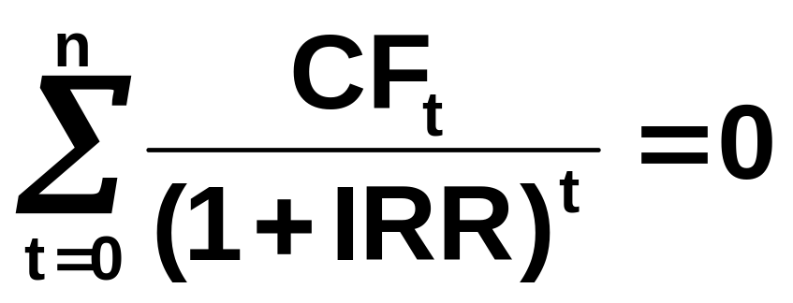
Multiple IRRs
Descartes Rule of Signs
Polynomial of degree n→n roots
  When you solve for IRR you are solving for the root of an equation
  1 real root per sign change
  Rest = imaginary (i² = -1)
Notes:
8.<number>

Slide 50
Non-Conventional Cash Flows
Suppose an investment will cost $90,000 initially and will generate the following cash flows:
  Year 1: 132,000
  Year 2: 100,000
  Year 3: -150,000
The required return is 15%.
Should we accept or reject the project?
Notes:
8.<number>

Slide 51
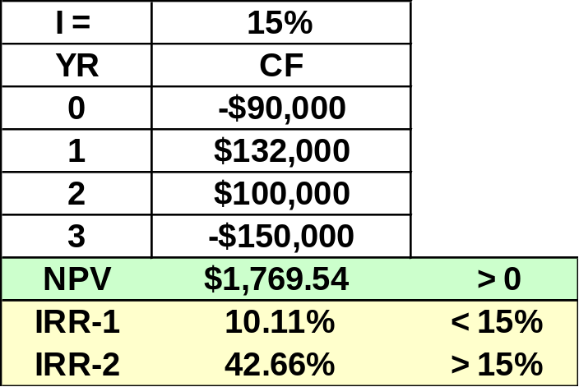

Non-Conventional Cash Flows
Summary of Decision Rules
NPV > 0 at 15% required return, so you should Accept
IRR =10.11% (using a financial calculator), which would tell you to Reject
Recognize the non-conventional cash flows and look at the NPV profile
Notes:
8.<number>

Slide 52
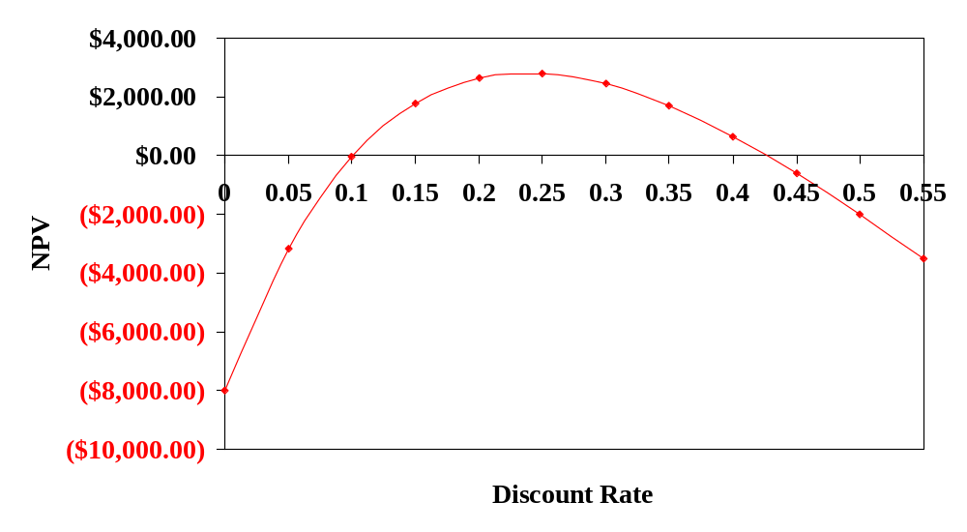
NPV Profile
IRR = 10.11% and 42.66%
When you cross the x-axis more than once, there will be more than one return that solves the equation
Notes:
8.<number>

Slide 53
Independent versus Mutually Exclusive Projects
Independent
  The cash flows of one project are unaffected by the acceptance of the other.
Mutually Exclusive
  The acceptance of one project precludes accepting the other.
Notes:
8.<number>

Slide 54
Reinvestment Rate Assumption
IRR assumes reinvestment at IRR
NPV assumes reinvestment at the firm’s weighted average cost of capital(opportunity cost of capital)
  More realistic
  NPV method is best
NPV should be used to choose between mutually exclusive projects
Notes:
8.<number>

Slide 55
Example of Mutually Exclusive Projects
Period | Project A | Project B
0 | -500 | -400
1 | 325 | 325
2 | 325 | 200
IRR | 19.43% | 22.17%
NPV | 64.05 | 60.74
The required return for both projects is 10%.
Which project should you accept and why?
Notes:
8.<number>

Slide 56
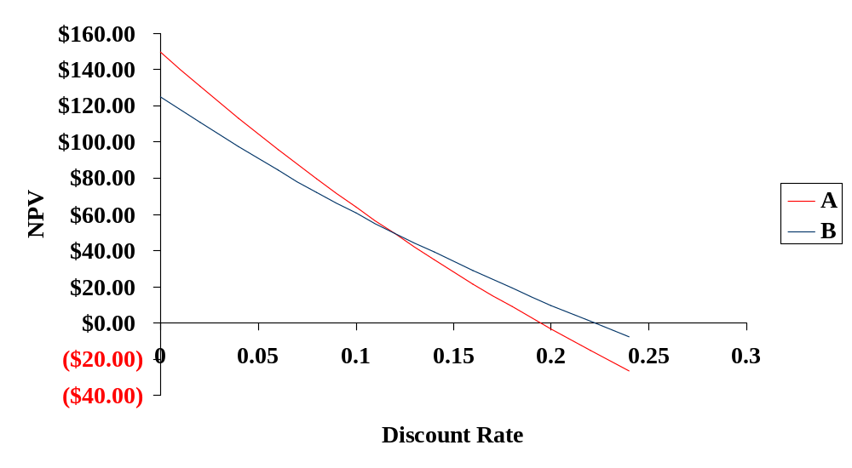
NPV Profiles
IRR for A = 19.43%
IRR for B = 22.17%
Crossover Point = 11.8%
Notes:
8.<number>

Slide 57
Two Reasons NPV Profiles Cross
Size (scale) differences.
  Smaller project frees up funds sooner for investment.
  The higher the opportunity cost, the more valuable these funds, so high discount rate favors small projects.
Timing differences.
  Project with faster payback provides more CF in early years for reinvestment.
  If discount rate is high, early CF especially good
Notes:
8.<number>

Slide 58
Conflicts Between NPV and IRR
NPV directly measures the increase in value to the firm
Whenever there is a conflict between NPV and another decision rule, always use NPV
IRR is unreliable in the following situations:
  Non-conventional cash flows
  Mutually exclusive projects
Notes:
8.<number>

Slide 59
Modified Internal Rate of Return (MIRR)
Controls for some problems with IRR
Method
  1.Discounting Approach = Discount future outflows to present and add to CF₀
  MIRR will be unique number for each method
  Discount (finance) / compound (reinvestment) rate externally supplied
Notes:
8.<number>

Slide 60
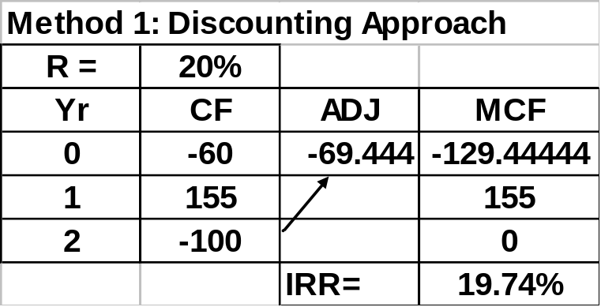
MIRR Method 1
Discounting Approach
Step 1: Discount future outflows (negative cash flows) to present and add to CF0
Step 2: Zero out negative cash flows which have been added to CF0.
Step 3: Compute IRR normally

Slide 61
MIRR versus IRR
MIRR correctly assumes reinvestment at opportunity cost = WACC
MIRR avoids the multiple IRR problem
Managers like rate of return comparisons, and MIRR is better for this than IRR

Slide 62
Profitability Index
Measures the benefit per unit cost, based on the time value of money
  A profitability index of 1.1 implies that for every $1 of investment, we create an additional $0.10 in value
Can be very useful in situations of capital rationing
Decision Rule: If PI > 1.0 → Accept
Notes:
8.<number>

Slide 63
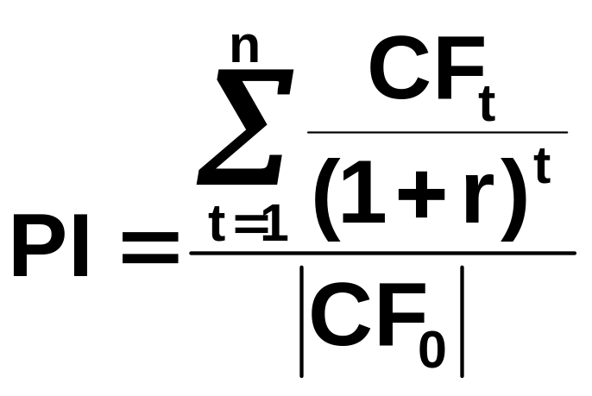
Profitability Index
For conventional CF Projects:
        PV(Cash Inflows)
        Absolute Value of Initial Investment
Notes:
8.<number>

Slide 64
Advantages and Disadvantages of Profitability Index
Advantages
  Closely related to NPV, generally leading to identical decisions
    Considers all CFs
    Considers TVM
  Easy to understand and communicate
  Useful in capital rationing
Disadvantages
  May lead to incorrect decisions in comparisons of mutually exclusive investments (can conflict with NPV)
Notes:
8.<number>

Slide 65
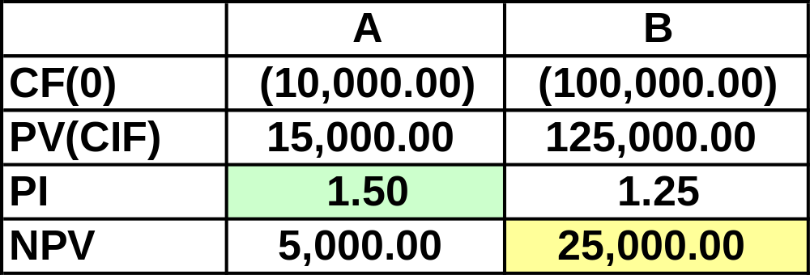
Profitability Index
Example of Conflict with NPV
Notes:
8.<number>

Slide 66
Capital Budgeting In Practice
Consider all investment criteria when making decisions
NPV and IRR are the most commonly used primary investment criteria
Payback is a commonly used secondary investment criteria
All provide valuable information
Notes:
8.<number>

Slide 67
Summary
Calculate ALL -- each has value
Method What it measures Metric
  NPV → $ increase in VF $$
  Payback → Liquidity Years
  IRR → E(R), risk %
Notes:
8.<number>

Slide 68
NPV Summary
Net present value =
  Difference between market value (PV of inflows) and cost
  Accept if NPV > 0
  No serious flaws
  Preferred decision criterion
Notes:
8.<number>

Slide 69
IRR Summary
Internal rate of return =
  Discount rate that makes NPV = 0
  Accept if IRR > required return
  Same decision as NPV with conventional cash flows
  Unreliable with:
    Non-conventional cash flows
    Mutually exclusive projects
  MIRR = better alternative
Notes:
8.<number>

Slide 70
Payback Summary
Payback period =
  Length of time until initial investment is recovered
  Accept if payback < some specified target
  Doesn’t account for time value of money
  Ignores cash flows after payback
  Arbitrary cutoff period
  Asks the wrong question
Notes:
8.<number>

Slide 71
Chapter 8
END
8-<number>
Notes:
8.<number>

